Slide 1
NPIP User Manual
Qaahir Arnold(ARNMOG014),
Vuxo Mashimby(MHMVUX001),
Uluthandolwethu Ntshweni(NTSULU001)

Slide 2
Introduction
The NPIP platform is designed to give users a convenient way to view, analyze and compare the performances of different networks in different parts of Africa.
This guide will help you navigate the Network Performance and Insights Platform (NPIP).

Slide 3

Contents
Dashboard
Dashboard
Network Speed Test
Save graphs
Compare Networks in a City
Compare City
Networks in Different Cities
Compare Networks
Compare Multiple Networks
Networks Over Time Analysis
Time Analysis

Slide 4

1. Dashboard
Welcome to the Network Performance Insight Platform. View the top performing networks in your city and test your own network speeds.
ThePhoto by PhotoAuthor is licensed under CCYYSA.

Slide 5
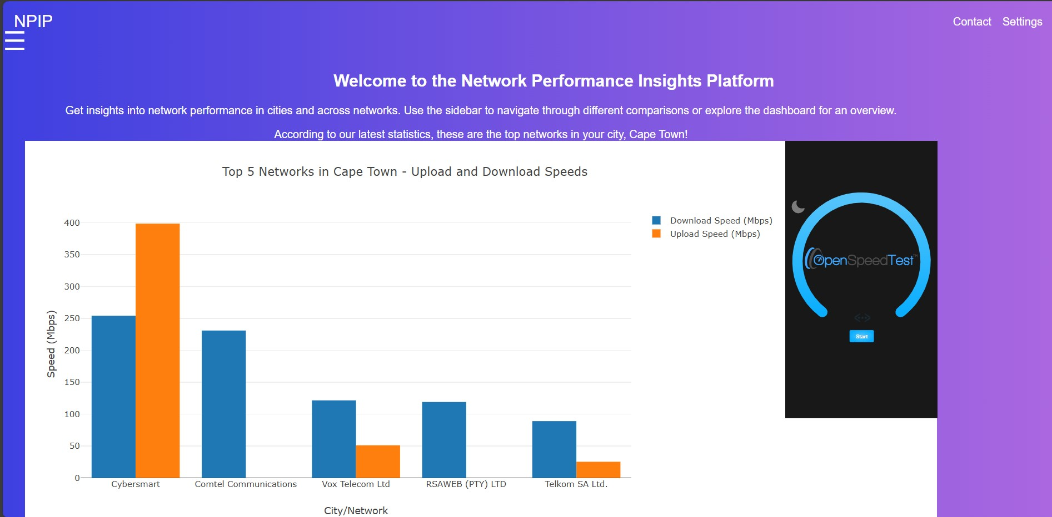
Dashboard
Upon opening the website, you will be directed to the dashboard. After accepting the prompt for accessing your location, you will find graphs that show 5 best performing networks in terms of Upload/Download speed and latency. There is also an option to run your own network speed test.

Slide 6
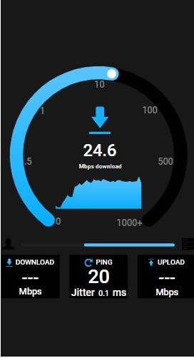
Network speed test
An "OpenSpeedTest" network speed test is run when you click the "Start" button.
CAUTION: the speed test uses a large amount of data.

Slide 7
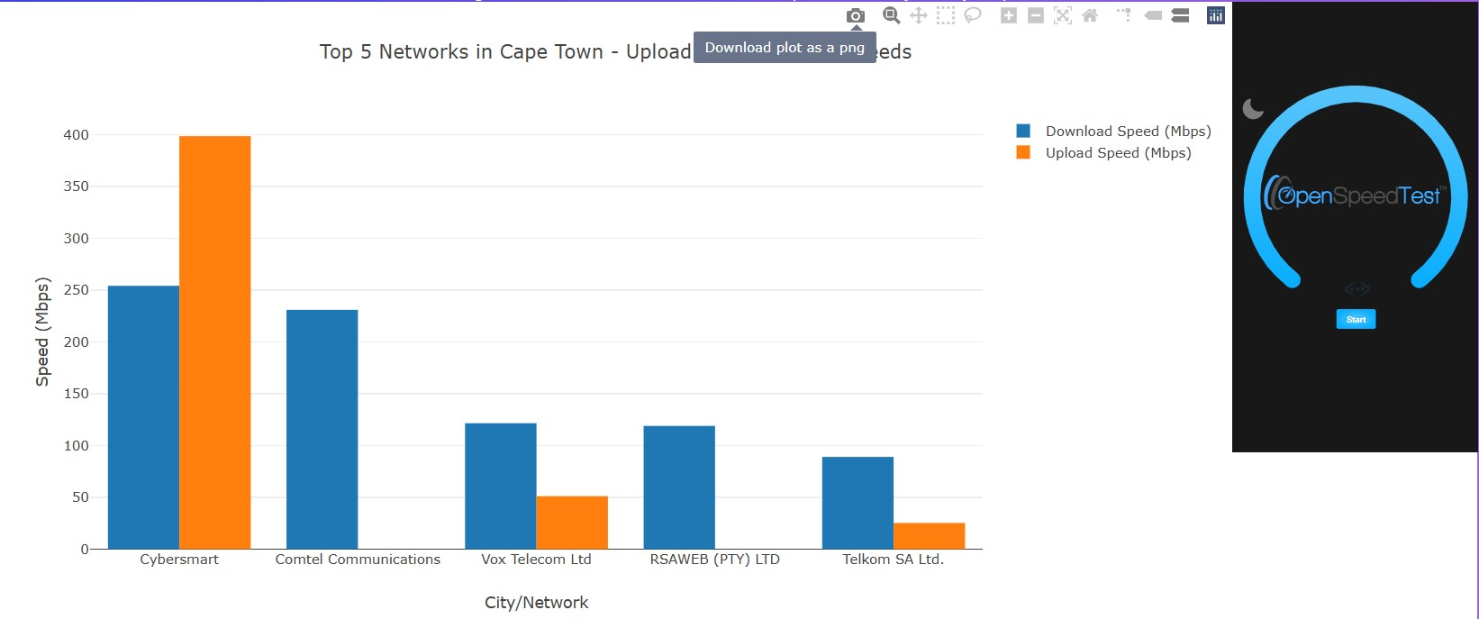
Save graph
You can toggle the view of the graph using the buttons that appear above the graph when you hover your cursor over the graph
Save the graph by clicking the camera button

Slide 8

2. Compare networks in a city
Compare the network speeds of different internet service providers in a city
ThePhoto by PhotoAuthor is licensed under CCYYSA.

Slide 9
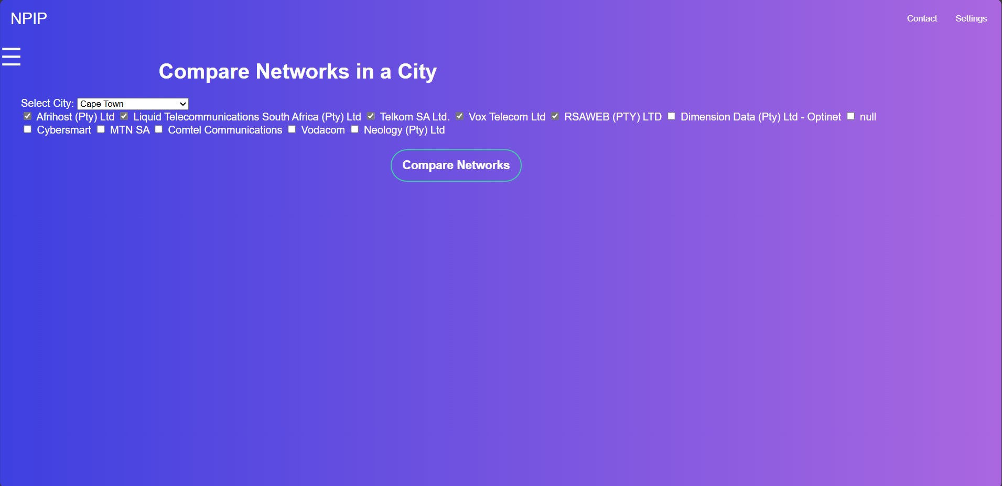
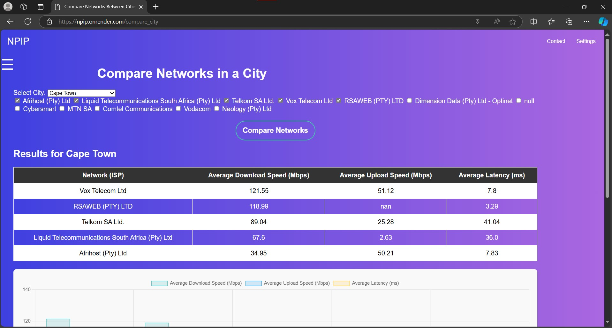
Compare city
1. Select the city which you want to test the network performance, then select the networks you want to test.
2. After the "Compare Networks" button is clicked, a table and a graph will be generated showing Upload/Download speeds(Higher is better) and Latency(Lower is better)

Slide 10

3. Networks in different cities
NPIP provides a way to directly compare different network performances from different cities.
Compare Networks: provides a comparison of ISPs that exist in both cities selected
Compare Multiple Networks: provides a comparison of ISPs, regardless of whether they exist in both cities.

Slide 11
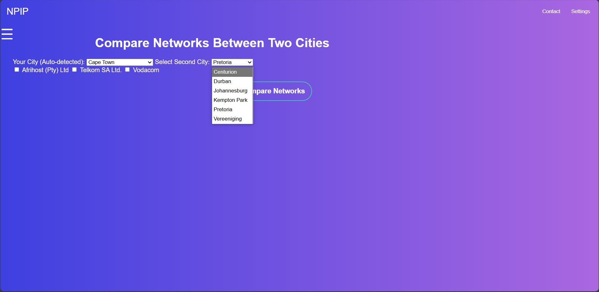
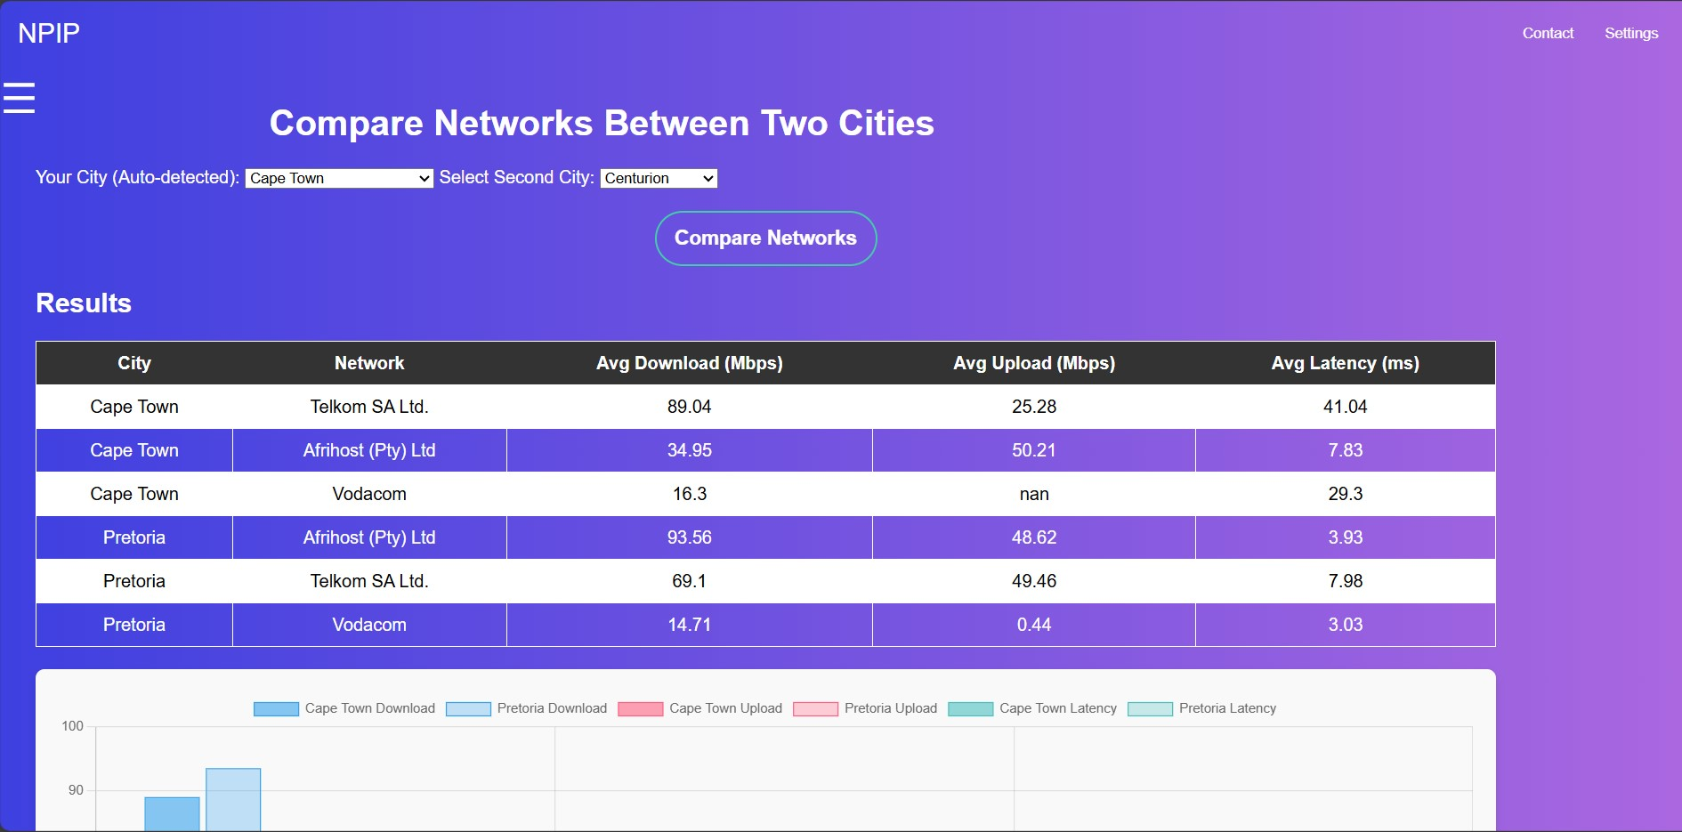
Compare networks
1. A) Select the city from the first dropdown(Your current location will be selected by default).
B) The second dropdown will only show cities that have common networks with the first.
C) Select the networks you want to compare that appear under the dropdown boxes.
2. After "Compare Networks" is clicked, a graph and a table will be generated showing the different Upload/Download Speeds(Higher is better) and Latency(Lower is better)

Slide 12
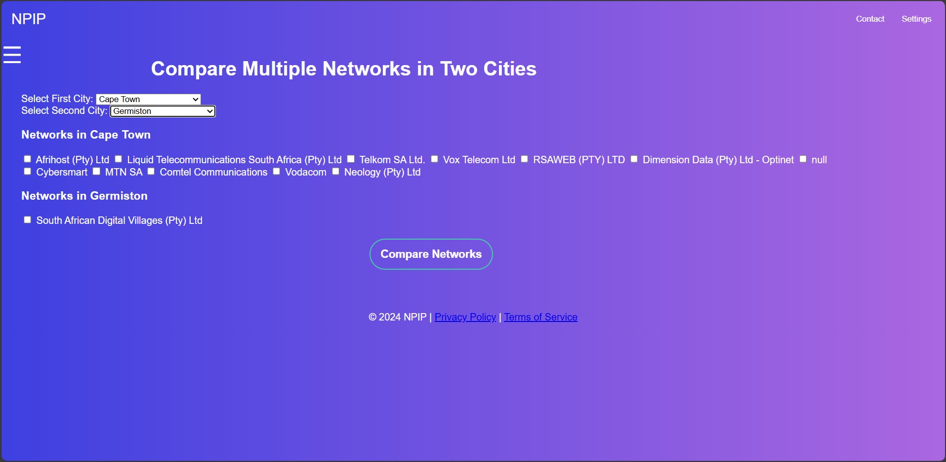
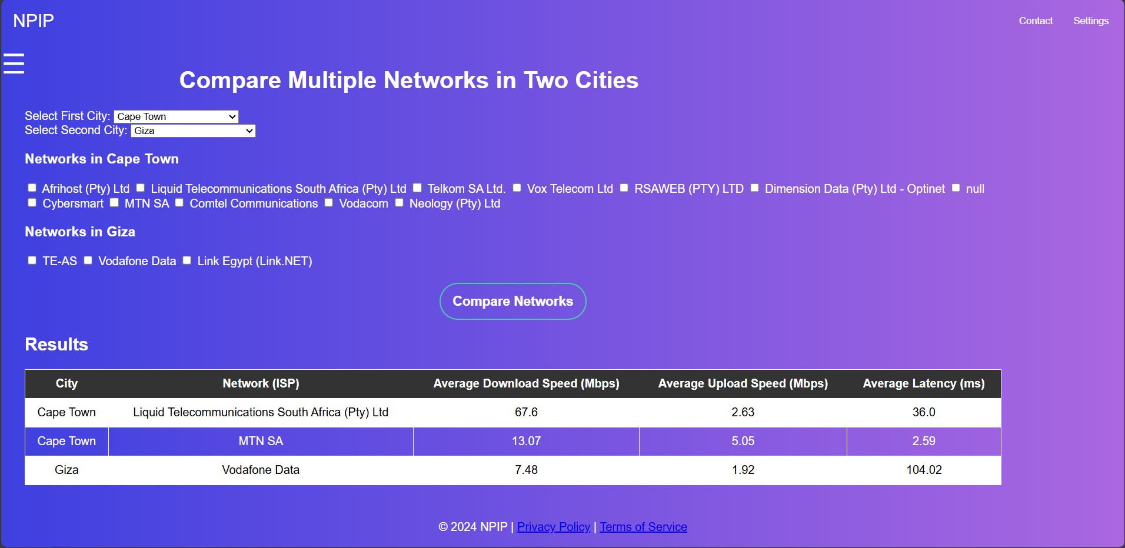
Compare Multiple Networks
1. A) Select the cities from the dropdown boxes, the select the networks you want to compare.
B) Select the "Compare Networks" button.
2. After "Compare Networks" is clicked, a graph and a table will be generated showing the different Upload/Download Speeds(Higher is better) and Latency(Lower is better)

Slide 13

3. Network over time analysis
Provides a way of viewing how a network's performance changes over time

Slide 14
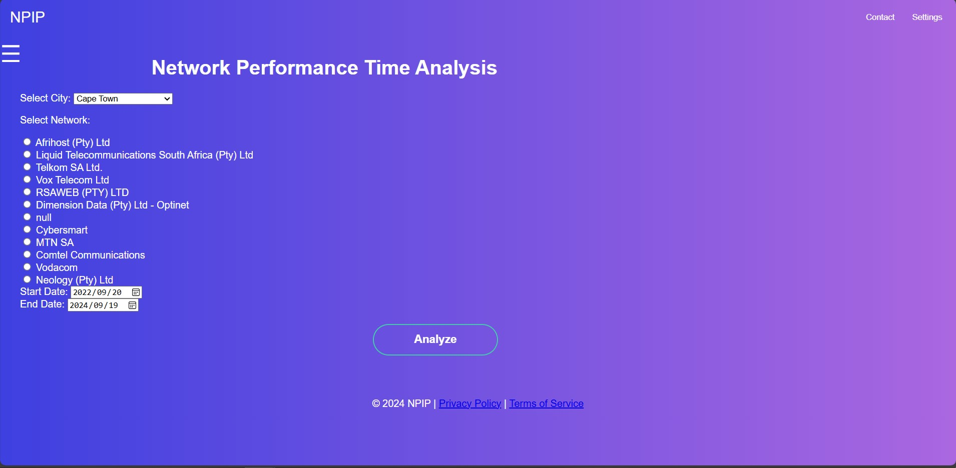
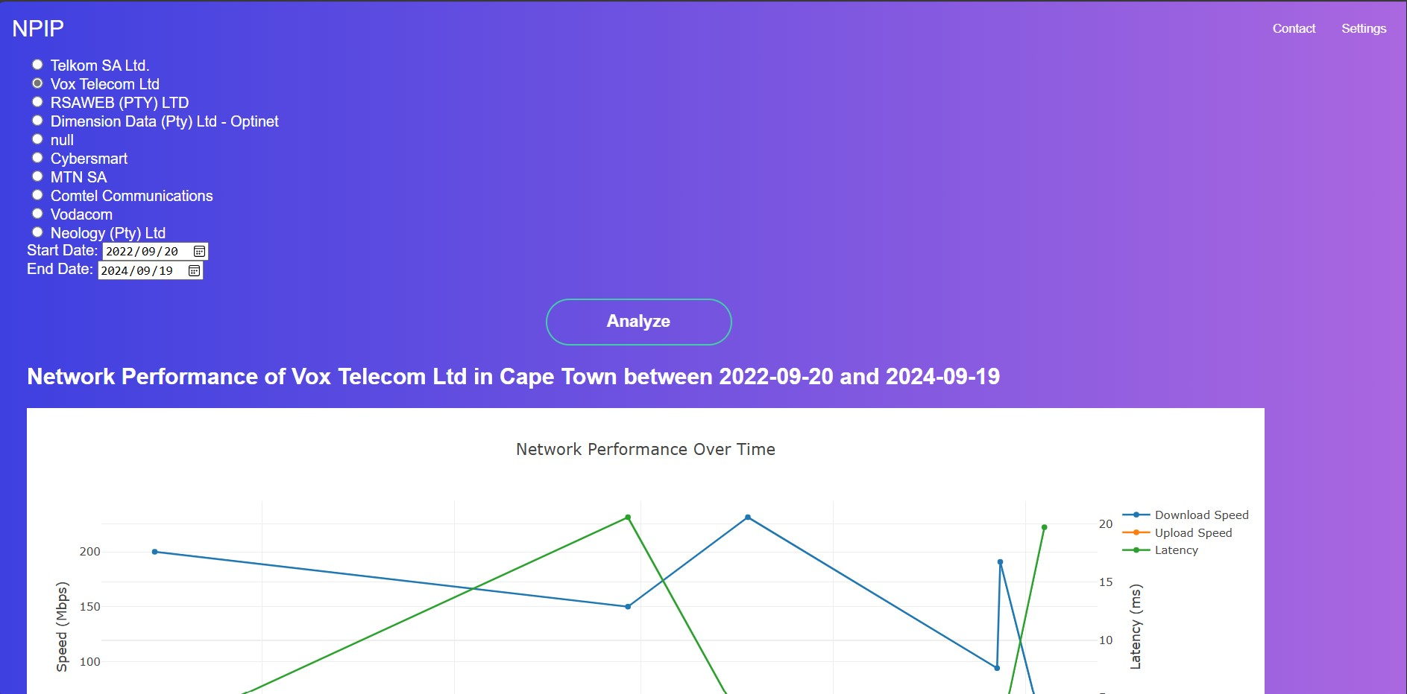
Time Analysis
1. Select a city from the dropdown box. A list of available ISPs will appear which you can click 1 from, choose a start date and an end date.
2. Click the "Analyze" button which will generate a line graph, showing the performance of the selected network over time.

Slide 15

Thank you
We hope that this guide has been helpful in learning to navigate and use the features of the NPIP platform.

